Slide 1
Trees
Binary search trees
Height Balanced Tree-AVL tree

Slide 2
Binary Search Trees
A BST is a binary tree. it satisfies the following properties:
Every element has a key, and no two elements have the same key, i.e., the keys are unique
The keys in a nonempty left subtree must be smaller than the key in the root of the subtree
The keys in a nonempty right subtree must be larger than the key in the root of the subtree
The left and right subtrees are also binary search trees

Slide 3
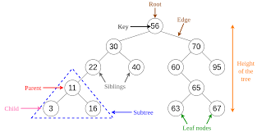

Slide 4
The average depth of a BST is log N where N is the number of nodes.
So, the time complexity of any operation is O(logN)

Slide 5
Operations
Create/Insertion
Search(Find)
Find min and max
Delete

Slide 6
Create/insert- example
Tree contains 100,20,500,10 and 30.
100
20 500
10 30
Insert 40
Means you have to insert it into the right part of 30.

Slide 7
Function to create/insert a BST
NODE insertBST(int item, NODE root)
{
NODE temp, cur, prev;
temp=(NODE)malloc(sizeof(struct node));
temp→data=item;
temp→llink=temp→rlink=NULL;
if(root==NULL)
return temp;
prev=NULL;
cur=root;
while(cur!=NULL)
{
prev=cur;
cur=(item<cur→data)?cur→llink:cur→rlink;
}
if(item<prev→data)
prev→llink=temp;
else
prev→rlink=temp;
return root;
}

Slide 8
Function to insert items avoiding duplicates
.
.
.
while(cur!=NULL)
{
prev=cur;
if(item==cur→data)
{
printf(“Duplicate element\n”);
free(temp);
return root;
}
cur=(item<cur→data)?cur→llink:cur→rlink;
}

Slide 9
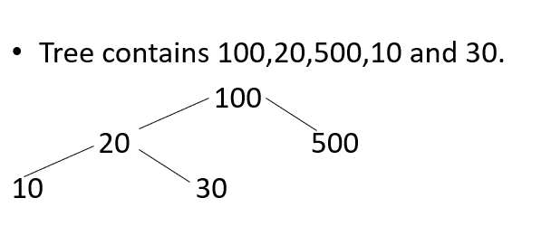
Search

Slide 10
Search the element 30
Search the element 50

Slide 11
Searching/Find
Iterative version
NODE interative_searchBST(int item, NODE root)
{
while(root!=NULL && item!=root→data)
root=(item<root→data)?root→llink:root→rlink);
return root;
}
Recursive version
NODE recursive_searchBST(int item, NODE root)
{
if(root==NULL||item==root→data) return root;
if(item<root→data) return recursive_searchBST(item, root→llink);
return recursive_searchBST(item, root→rlink);
}

Slide 12
Function to find the maximum element in a BST
NODE maximum_BST(NODE root)
{
NODE cur;
if(root==NULL) return root;
cur=root;
while(cur→rlink!=NULL)
cur=cur→rlink;
return cur;
}
Student work out:
Similarly write a function to find the minimum element in a BST
Notes:
Maximum->right tree,minimum->left tree

Slide 13
Delete a node from the BST
Possibilities: A node to be deleted may have
1. May be a leaf
2. An empty left subtree and nonempty right subtree
3. An empty right subtree and nonempty left subtree
4. Nonempty left subtree and nonempty right subtree

Slide 14
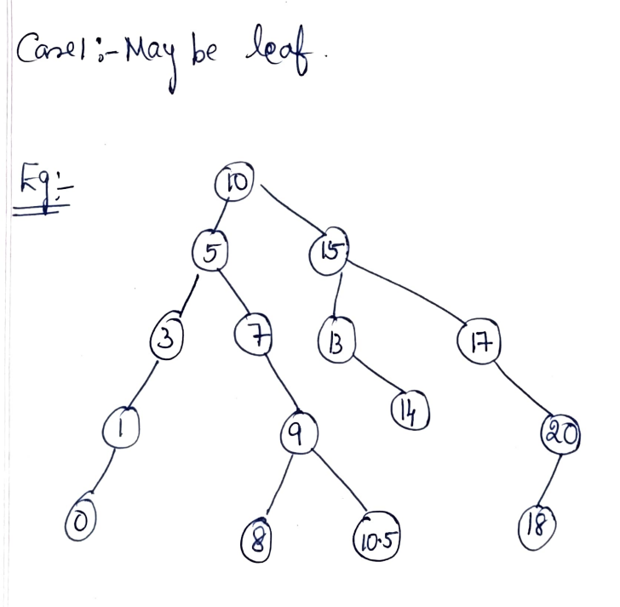

Slide 15
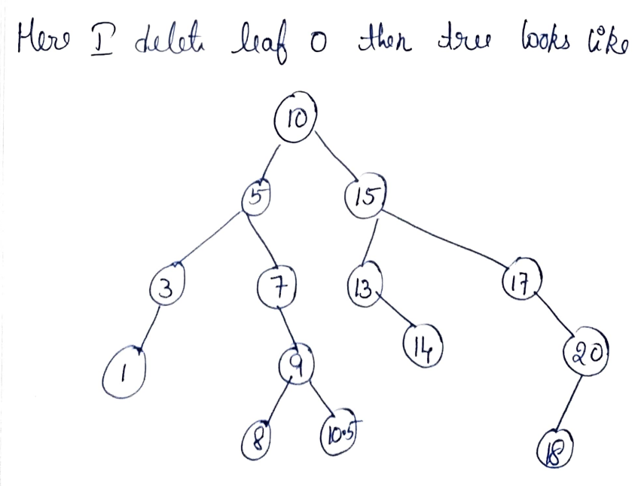

Slide 16

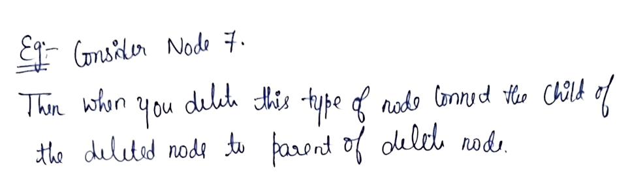

Slide 17
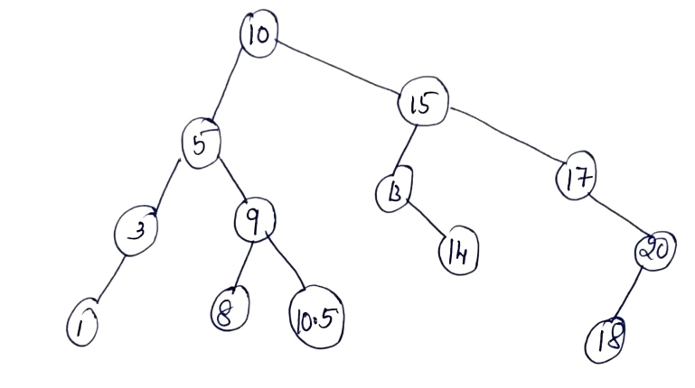

Slide 18
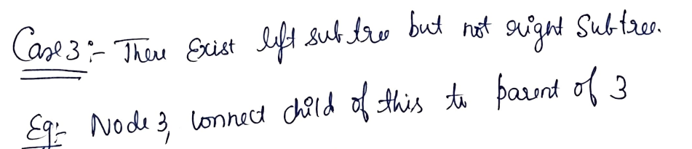
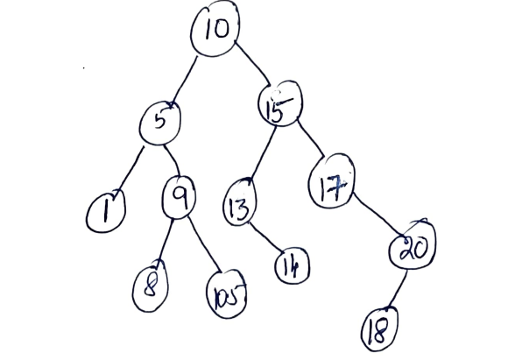

Slide 19
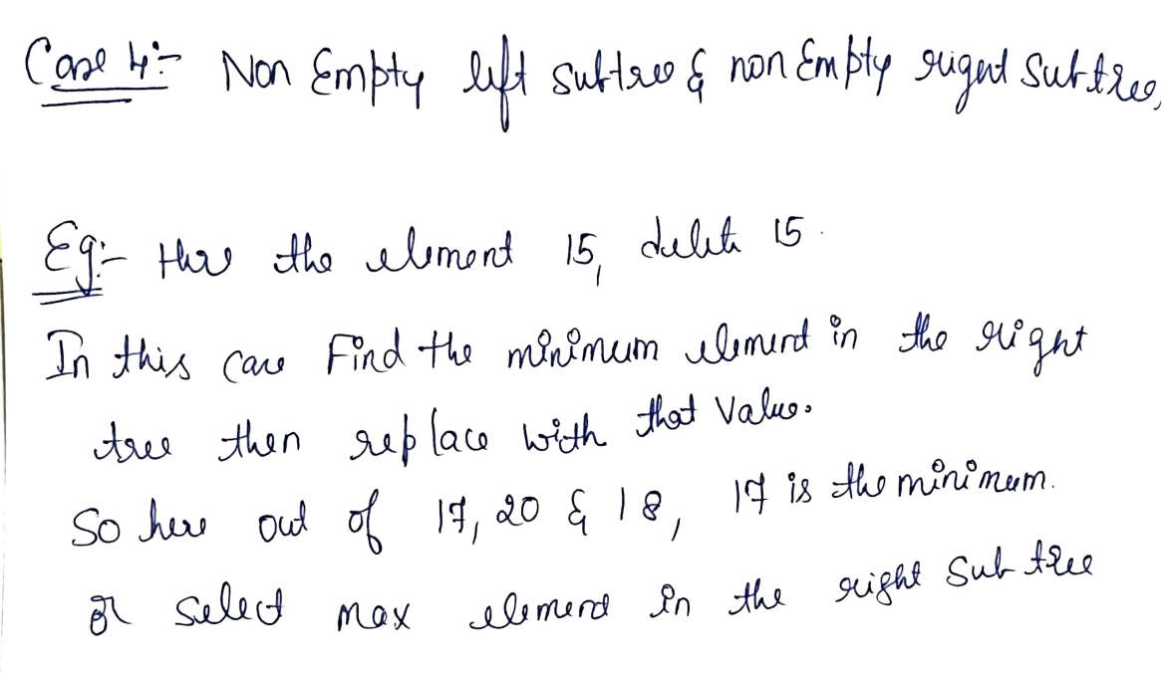

Slide 20
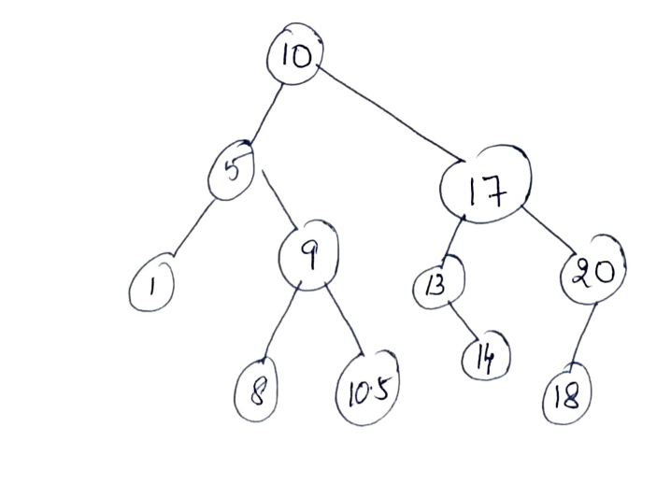

Slide 21
AVL-Trees (Adelson-Velskii and Landis-Trees)

Slide 22
Balanced binary tree
The disadvantage of a binary search tree is that its height can be as large as N-1
This means that the time needed to perform insertion and deletion and many other operations can be O(N) in the worst case
We want a tree with small height
A binary tree with N node has height at least Θ(log N)
Thus, our goal is to keep the height of a binary search tree O(log N)
Such trees are called balanced binary search trees. Examples are AVL tree, red-black tree.

Slide 23
AVL tree
Height of a node
The height of a leaf is 0. The height of an empty tree is -1.
The height of an internal node is the maximum height of its children plus 1

Slide 24
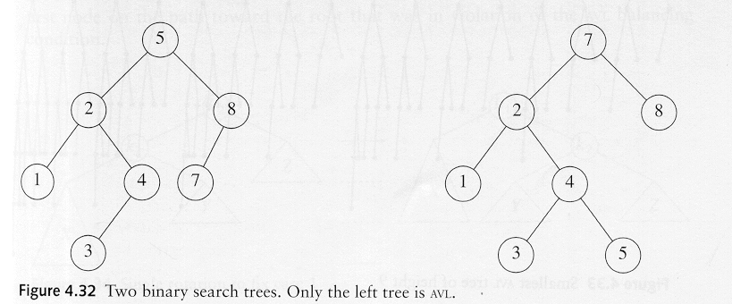
AVL tree
An AVL tree is a binary search tree in which
for every node in the tree, the height of the left and right subtrees differ by at most 1.
AVL property violated here

Slide 25
AVL tree
Let x be the root of an AVL tree of height h
Let S(h) denote the minimum number of nodes in an AVL tree of height h.
S(h)=S(h-1)+S(h-2)+1
Many operations (searching, insertion, deletion) on an AVL tree will take O(log N) time.

Slide 26
Rotations
When the tree structure changes (e.g., insertion or deletion), we need to transform the tree to restore the AVL tree property.
This is done using single rotations or double rotations.
e.g. Single Rotation
y
x
x
y
C
A
C
B
B
A
Before Rotation
After Rotation

Slide 27
Rotations
Since an insertion/deletion involves adding/deleting a single node, this can only increase/decrease the height of some subtree by 1
Thus, if the AVL tree property is violated at a node x, it means that the heights of left(x) and right(x) differ by exactly 2.
Rotations will be applied to x to restore the AVL tree property.

Slide 28
Insertion
First, insert the new key as a new leaf just as in ordinary binary search tree
Then trace the path from the new leaf towards the root. For each node x encountered, check if heights of left(x) and right(x) differ by at most 1.
If yes, proceed to parent(x). If not, restructure by doing either a single rotation or a double rotation
For insertion, once we perform a rotation at a node x, we don’t need to perform any rotation at any ancestor of x.

Slide 29
Insertion
Let x be the node at which left(x) and right(x) differ by more than 1
A violation may occur in four cases:
1. An insertion into the left subtree of the left child of x
2. An insertion into the right subtree of the left child of x
3. An insertion into the left subtree of the right child of x.
4. An insertion into the right subtree of the right child of x.

Slide 30
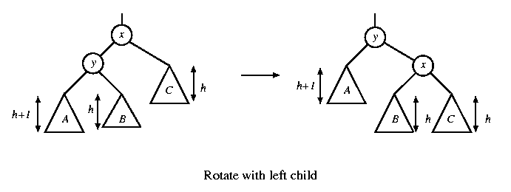
Single rotation
The new key is inserted in the subtree A.
The AVL-property is violated at x
height of left(x) is h+2
height of right(x) is h.

Slide 31
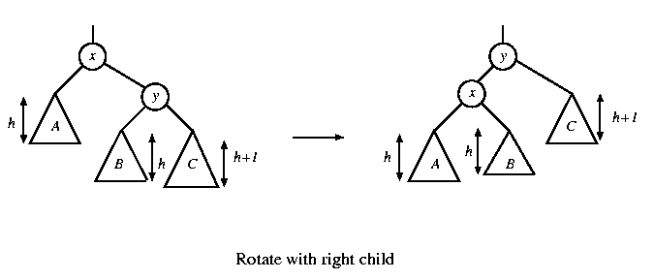
Single rotation
The new key is inserted in the subtree C.
The AVL-property is violated at x.
Single rotation takes O(1) time.
Insertion takes O(log N) time.

Slide 32
x
AVL Tree
5
5
y
8
C
3
3
8
1
4
B
1
4
A
0.8
Insert 0.8
3
5
1
After rotation
4
8
0.8

Slide 33
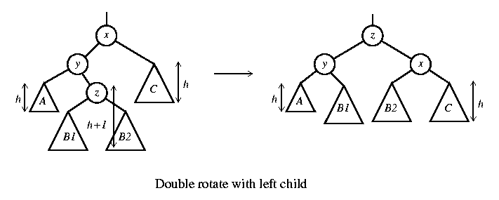
Double rotation
The new key is inserted in the subtree B1 or B2.
The AVL-property is violated at x.
x-y-z forms a zig-zag shape
also called left-right rotate

Slide 34
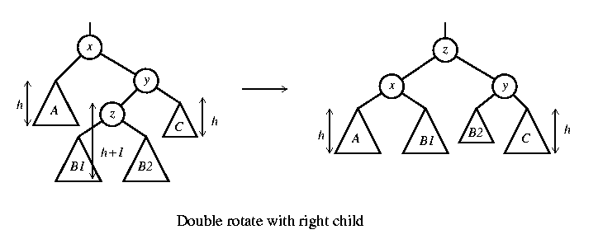
Double rotation
The new key is inserted in the subtree B1 or B2.
The AVL-property is violated at x.
also called right-left rotate

Slide 35
x
5
AVL Tree
5
C
y
8
3
3
8
A
1
4
z
1
4
B
3.5
Insert 3.5
4
5
3
3.5
8
After Rotation
1

Slide 36
An Extended Example
Insert 3,2,1,4,5,6,7, 16,15,14
Single rotation
3
2
3
3
2
1
Fig 1
2
3
Fig 4
Fig 2
2
1
2
Single rotation
Fig 3
1
1
3
3
Fig 5
Fig 6
4
4
5

Slide 37
2
2
Single rotation
1
4
1
4
3
5
3
5
Fig 8
Fig 7
6
4
4
Single rotation
2
5
2
5
1
3
6
1
3
6
4
Fig 9
Fig 10
7
2
6
1
3
7
5
Fig 11

Slide 38
4
2
6
1
3
7
5
16
Fig 12
4
Double rotation
4
2
6
2
6
1
3
7
1
3
15
5
16
5
16
Fig 13
7
15
Fig 14

Slide 39
4
4
Double rotation
2
6
2
7
15
1
3
15
1
3
5
6
16
7
5
14
16
Fig 15
14
Fig 16

